Slide 1
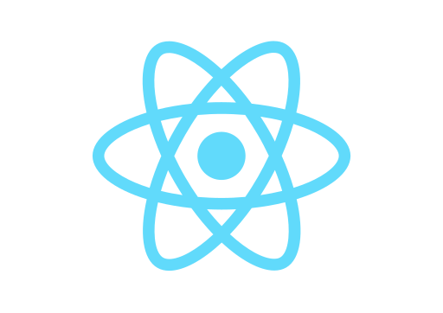

React & Netlify
Deploy React App to Netlify

Slide 2

Netlify is an all-in-one platform for deploying and automating modern web projects. Simply push and it will provides everything: servers, CDN, continuous delivery, HTTPS, staging environments, prerendering, asset post processing, DNS, and more. Any project, big or small, can perform instantly on a global scale.
First, sign up to www.netlify.com

Slide 3
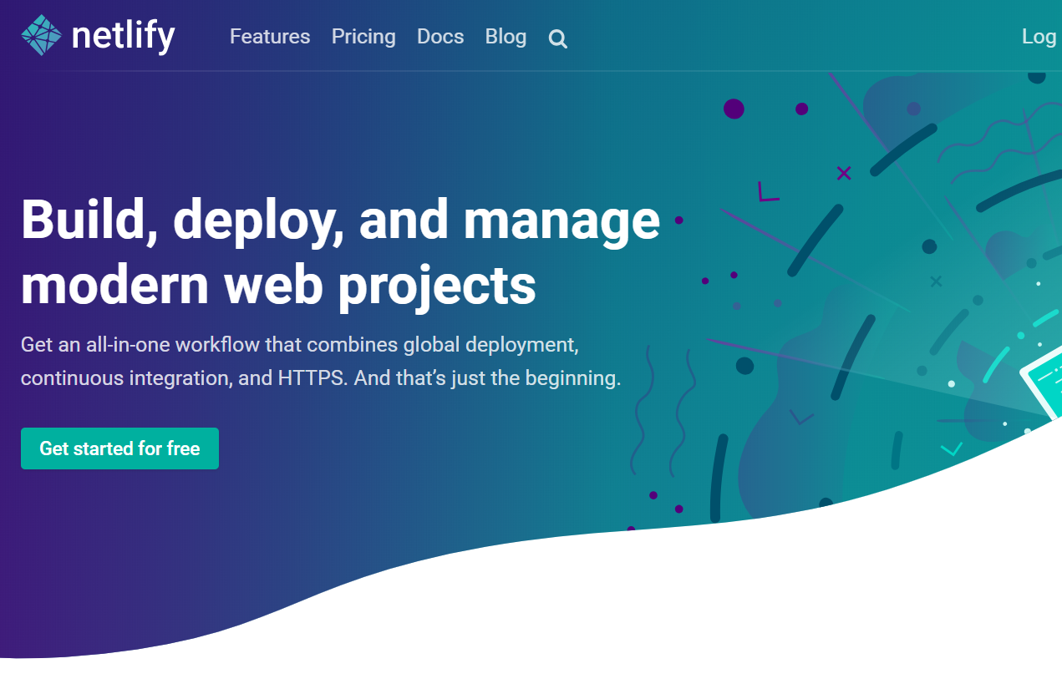
Easier to sign up with Github!

Slide 4
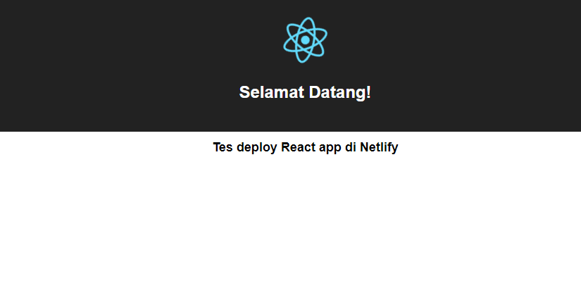
http://nifty-goldstine-e00a67.netlify.com/

Slide 5
#1 Create/Prepare Your React App
Install create-react-app utility globally on your PC (if you have not done yet before)
$ npm install -g create-react-app
Create a new react app or prepare yours
$ create-react-app linsip
$ cd linsip
Make sure that it runs successfully
$ npm run build

Slide 6
#2 Deploy to Netlify
Install netlify-cli globally on your PC
$ npm install -g netlify-cli
Deploy it!
$ netlify deploy
? No site id specified, create a new site? Yes
? Path to deploy? (current dir) ./build
Deploy is live (permalink):
http://5a83977d0b79b768362fc98c.nifty-goldstine-e00a67.netlify.com
Done!

Slide 7
http://nifty-goldstine-e00a67.netlify.com/

Slide 8
React & Netlify
Deploy React App to Netlify

